Slide 1
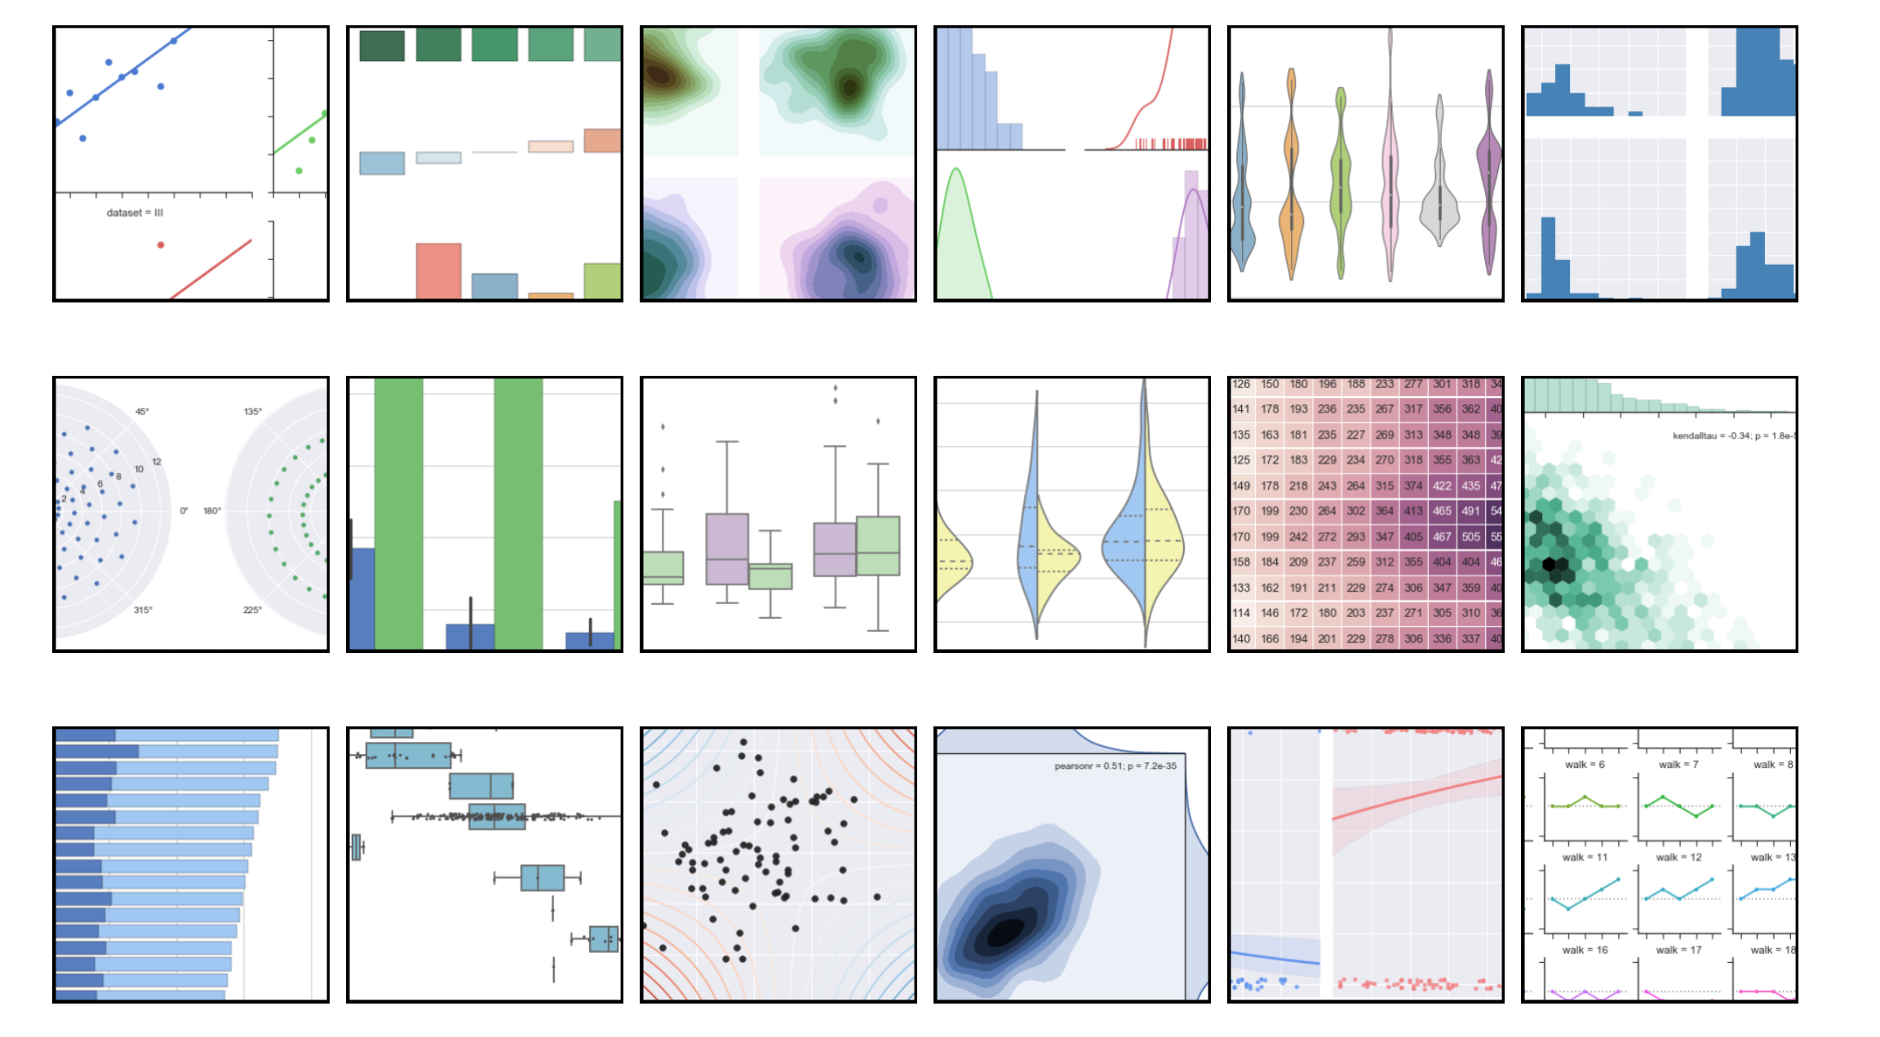
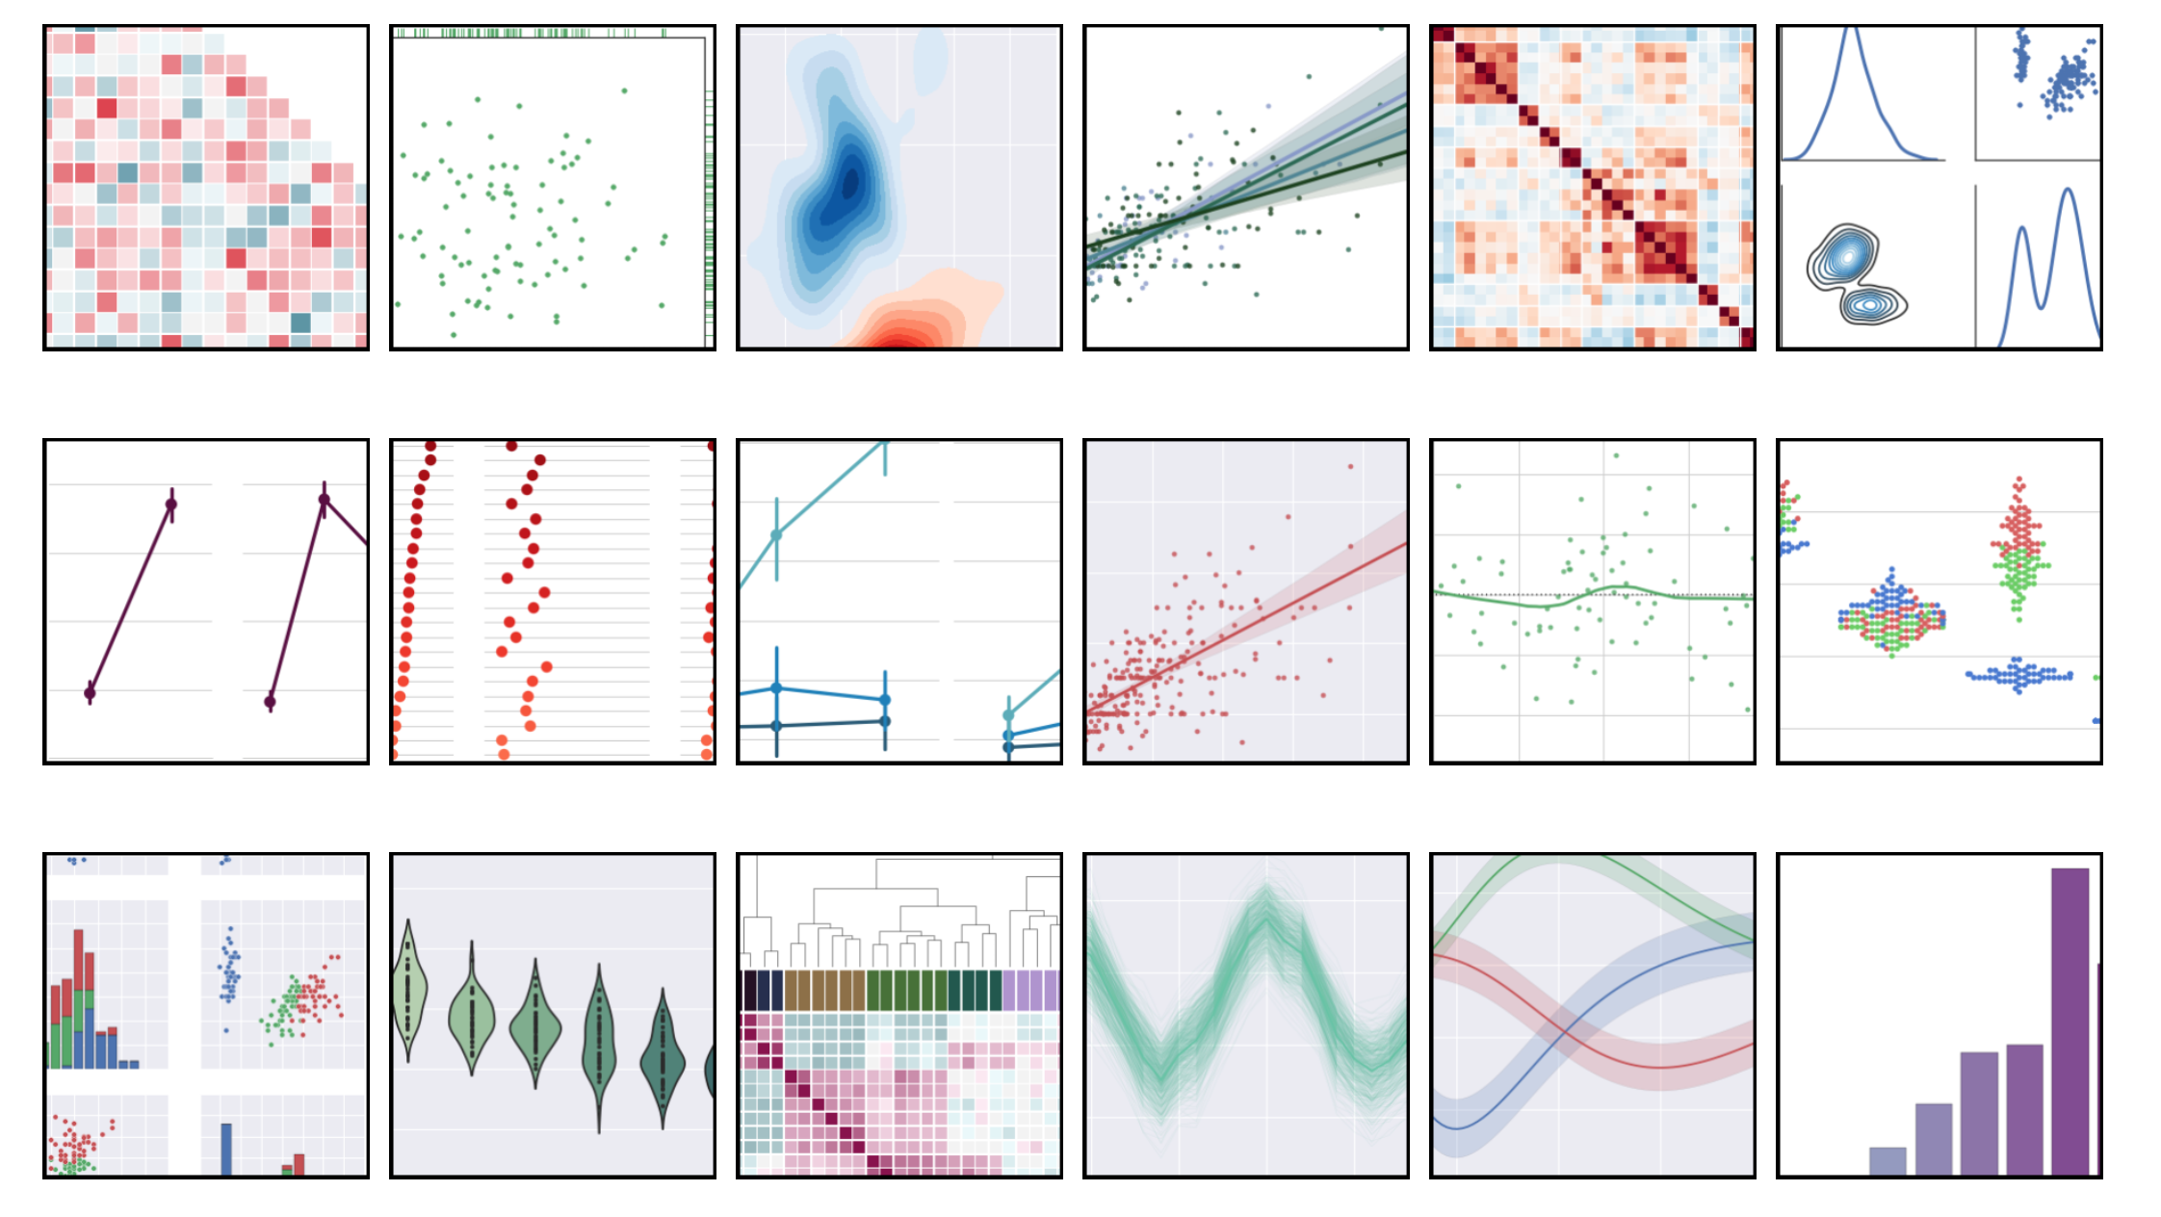
conda install seaborn
Mandatory Dependencies
bumpy, scipy, matplotlib, pandas
Recommended Dependencies
statsmodels, patsy
seaborn is great visualization library for statistical dataset make a lots of data plot for visualising data. You can choose color palette and color bind options.
https://stanford.edu/~mwaskom/software/seaborn/tutorial/color_palettes.html

Slide 2
# Standard
import numpy as np
import pandas as pd
from numpy.random import randn
# Stats
from scipy import stats
# Plotting
import matplotlib as mpl
import matplotlib.pyplot as plt
import seaborn as sns
%matplotlib inline
allow to see our plots in python notebook
url = 'http://en.wikipedia.org/wiki/Histogram'
dataset1 = randn(100)
100 data points
plt.hist(dataset1)
Graph 1 that has 10 bins default number of bins

Slide 3
dataset2 = randn(80)
plt.hist(dataset2,color='indianred')
fast the color argument to indianred
plt.hist(dataset1,normed=True,color='indianred',alpha=0.5,bins=20)
plt.hist(dataset2,normed=True,alpha=0.5,bins=20)
both histogram on the same plot
since dataset1 and 2 has different numbers data points 80 pts. 100 pts. We need to normalised my plot. by passing the argument to normed = True; to control transparent we need Apha. double up the bins. // see the Graph 2
data1 = randn(1000)
data2 = randn(1000)
lets say a thousand points with 2 large data set represent this a joint using method joint plot and call data1 and 2 // See the Graph 3
sns.jointplot(data1,data2)
sns.jointplot(data1,data2,kind='hex')
for more concise picture hex bins see the Graph 4

Slide 4
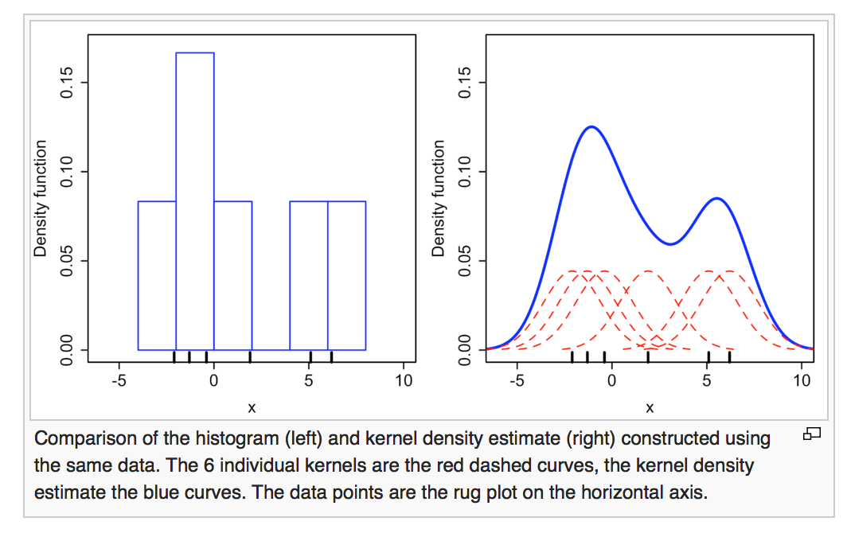
KERNEL DENSITY ESTIMATION (KDE) PLOTS
is a non-parametric way to estimate the probability density function of a random variable. Kernel density estimation is a fundamental data smoothing problem where inferences about the population are made, based on a finite data sample.
Gaussian curve

Slide 5
# The normal imports
import numpy as np
from numpy.random import randn
import pandas as pd
# Import the stats library from numpy
from scipy import stats
# These are the plotting modules:
import matplotlib as mpl
import matplotlib.pyplot as plt
import seaborn as sns
%matplotlib inline

Slide 6
sns.rugplot(dataset)
x_min = dataset.min() - 2
x_max = dataset.max() + 2
x_axis = np.linspace(x_min,x_max,100)
bandwidth = ((4*dataset.std()**5)/(3*len(dataset)))**0.2
kernel_list = []
for data_point in dataset:
# Create a kernel for each point and append it to thkernel_list
kernel = stats.norm(data_point,bandwidth).pdf(x_axis)
kernel_list.append(kernel)
# Scale for plotting
kernel = kernel / kernel.max()
kernel = kernel * 0.4
plt.plot(x_axis,kernel,color='grey',alpha=0.5)
plt.ylim(0,1)
dataset = randn(25)
setup x axis with min and max
set x axis 100 equal space points linear spacing
from xmin and xmax
sns.rugplot(dataset)
plt.ylim(0,1)
G1
G2(upper and lower limit)
list from kernel make a for loop to build up the list
plt.hist(dataset,alpha=0.3)
sns.rugplot(dataset)
G3
First Part : create kernel points
singular tick
G3 explain about the for every bin just accounting
how many tick ( | )
1st bin has one tick on it . the bin has 1 high.
next bin is o tick and making the bar make high
KDE plots represent each tick mark with gaussian
basis function.
use scipy stats library to do that normally distributed
probability density function method using x_axis
Second Part :
gaussian basis
resize everything about 40%
Click the graph normalise everything from the max 0.4

Slide 7
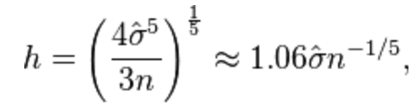
estimation of the bandwidth equation
4x standard deviation to the power 5 over 3 times of n where n is the number of points in your data set and all of this
to the power of 1/5 or 0.2
sum_of_kde = np.sum(kernel_list,axis=0)
fig = plt.plot(x_axis,sum_of_kde,color='indianred')
sns.rugplot(dataset)
plt.yticks([])
plt.suptitle("Sum of the basis functions")
to get kernel density estimation plot we need to sum of those we can say
view the tick

Slide 8
So, we do it in a long way we can do this in 1 simple step using seaborn
sns.kdeplot(dataset)
you can do kernel density using seaborn
we can adjust the bandwidth
sns.rugplot(dataset,color='black')
for bw in np.arange(0.5,2,0.25):
sns.kdeplot(dataset,bw=bw,lw=1.8,label=bw)
//Transparent
//see graph
we can adjust the bandwidth
url = 'http://en.wikipedia.org/wiki/Kernel_(statistics)'
kernel_options = ['biw','cos','epa','gau','tri','triw']
for kern in kernel_options:
sns.kdeplot(dataset,kernel=kern,label=kern)
//see graph
bounce of density type
for kern in kernel_options:
sns.kdeplot(dataset,kernel=kern,label=kern,shade=True)
//see graph to shade
sns.kdeplot(dataset,vertical=True)
//see graph in vertical axis
sns.kdeplot(dataset,cumulative = True)
CumulativeDistributionFunction

Slide 9
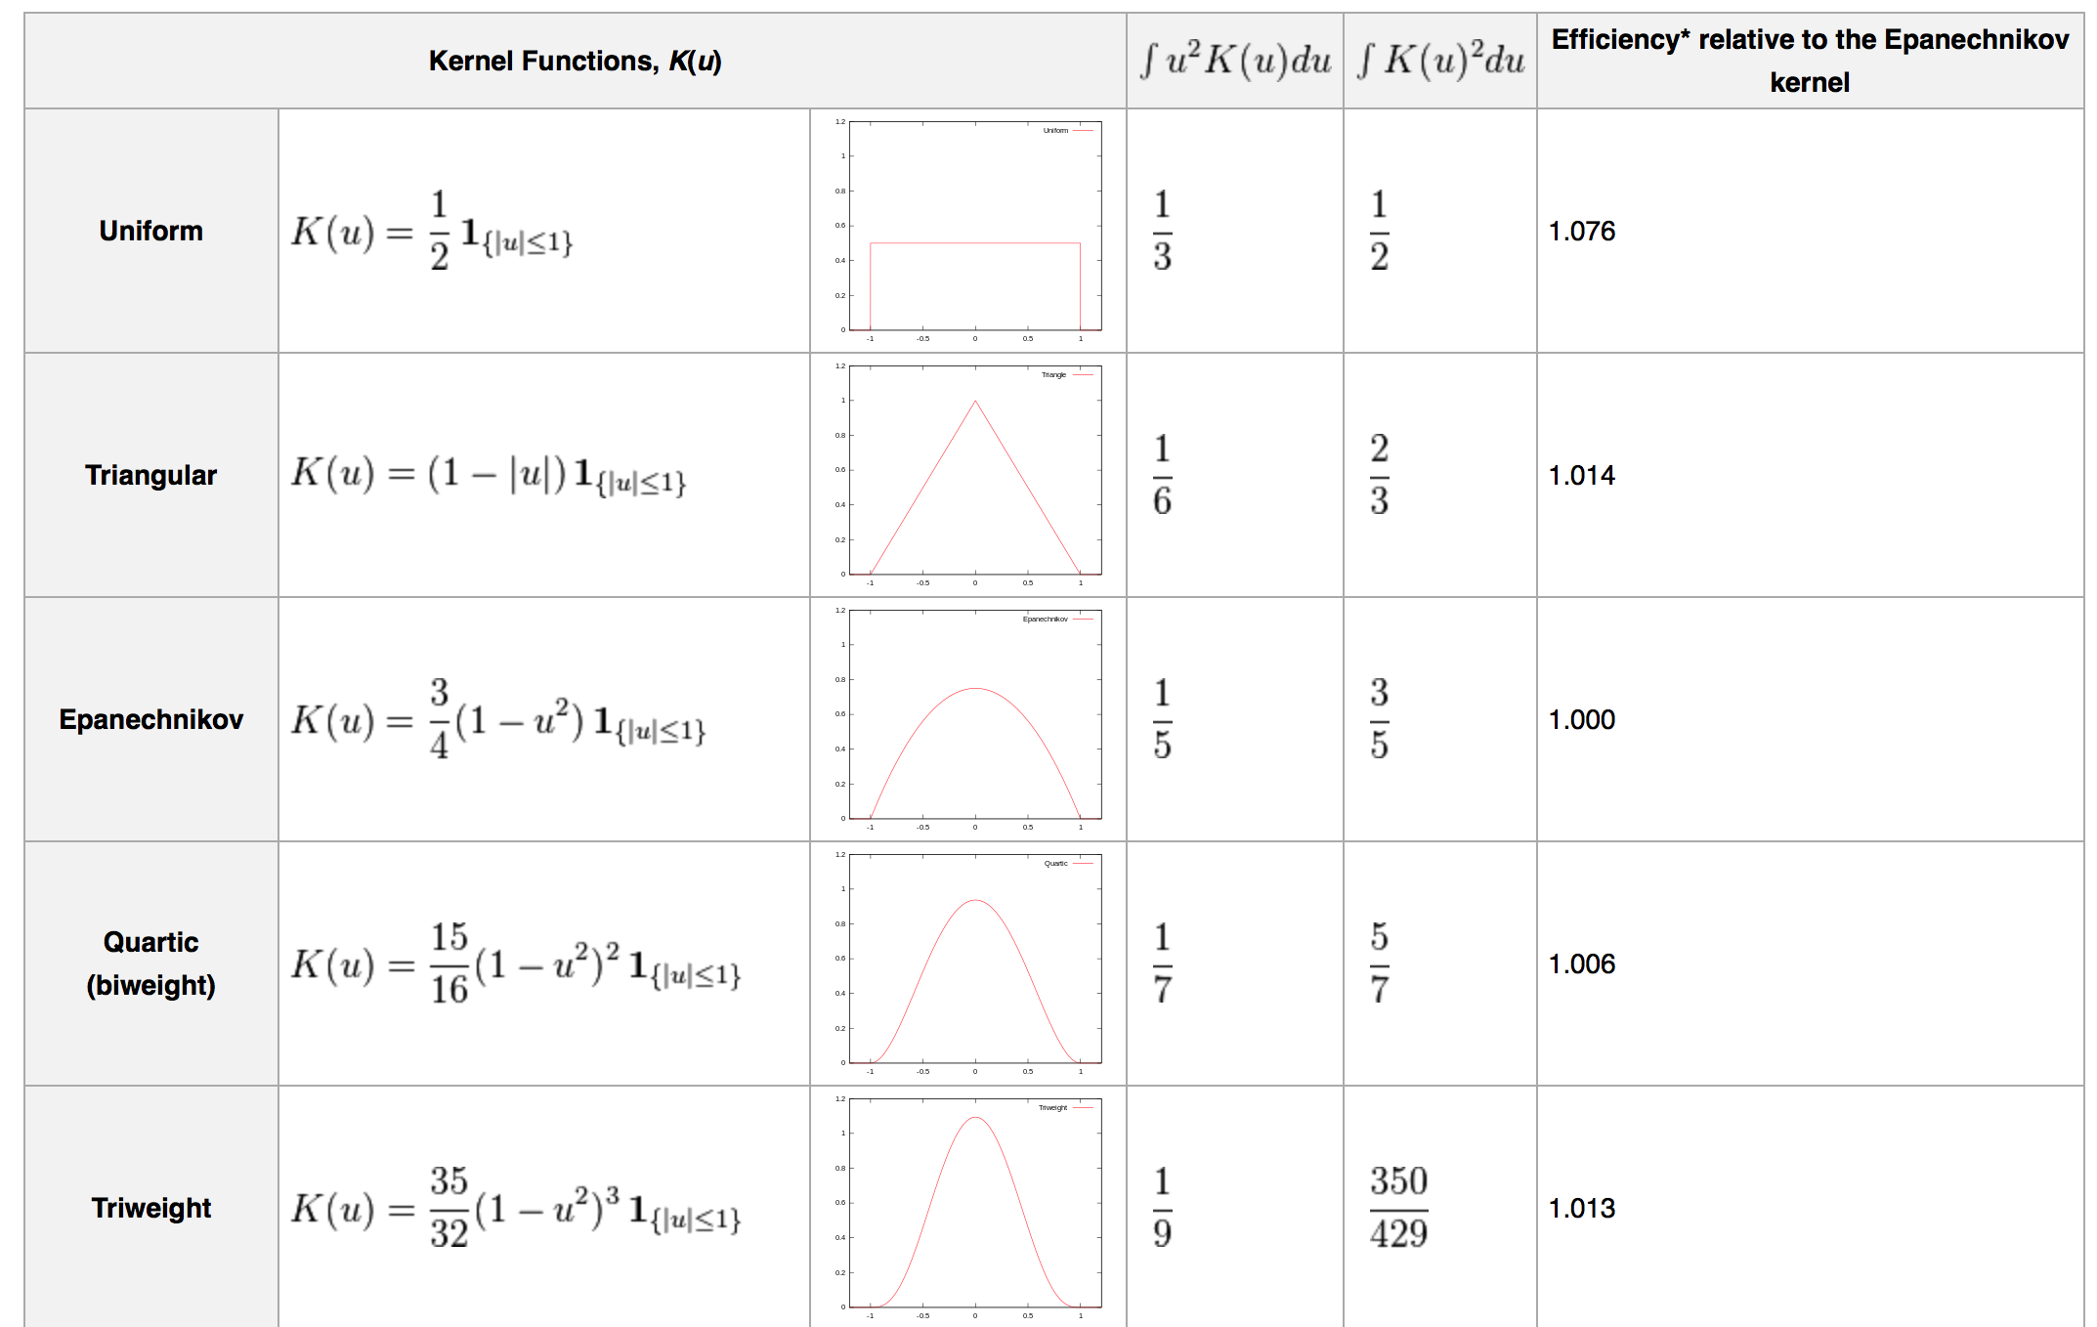

Slide 10
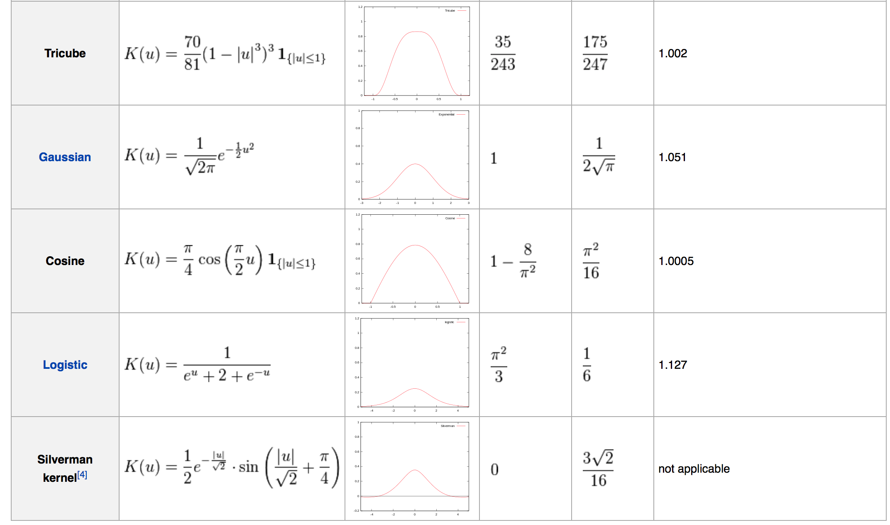

Slide 11
mean = [0,0]
cov = [[1,0],[0,100]] # Covariance
dataset2 = np.random.multivariate_normal(mean,cov,1000)
dframe = pd.DataFrame(dataset2,columns=['X','Y'])
sns.kdeplot(dframe)
mean for the center of the data
see Graph
sns.kdeplot(dframe.X,dframe.Y)
2 vector see Graph
sns.kdeplot(dframe.X,dframe.Y,shade=True)
see Graph shaded
instead contour line
sns.kdeplot(dframe,bw=1)
see Graph bandwidth change = 1
sns.kdeplot(dframe,bw='silverman')
silverman string bandwidth
sns.jointplot('X','Y',dframe,kind='kde')
kind of joint plot is kde

